Slide 1

NCPWB
WELDER PERFORMANCE QUALIFICATIONS
POLICY
&
PROCEDURE

Slide 2

NATIONAL CERTIFIED
PIPE WELDING BUREAU
“TESTING EVENT”
POLICY & PROCEDURE
“TRAINING PROGRAM”

Slide 3

NCPWB POLICY & PROCEDURE
A tutorial for the Contractor when
participating in a Joint Welder
Qualification testing event with the
United Association
Welder Certification Program

Slide 4
As the NCPWB member contractor present during United Association welder/brazer qualification testing, you are satisfying the requirements in ASME Section IX, Para. QW-300.2 and QB-300.2, which states in part that
“…welders/brazers or welding operators/brazing operators…shall be tested under the full supervision and control of the manufacturer, contractor, assembler or installer…”

Slide 5
The NCPWB Technical Committee has recommended and the NCPWB
Board of Trustees has approved the following to be followed by the participating contractor.

Slide 6
NCPWB
WELDER PERFORMANCE QUALIFICATIONS
IN-PROCESS RESPONSIBILITIES
SECTION – I.

Slide 7
I. CONTRACTOR’S & ATR’S
RESPONSIBILITIES
DURING A TESTING EVENT
Whenever a welder/brazer is tested, there shall be a NCPWB member contractor present in the facility where the test coupon will be welded/brazed. This person shall be a regular paid employee of a NCPWB contractor. This contractor shall work together with the UA Authorized Testing Representative (ATR) in administering the test.

Slide 8
CONTRACTOR’S & ATR’S
RESPONSIBILITIES DURING TESTING
The following tasks shall be performed by the contractor in coordination with the UA Authorized Testing Representative (ATR) prior to and during the welding/brazing of the test coupon/coupons:

Slide 9
CONTRACTOR’S & ATR’S
RESPONSIBILITIES DURING TESTING
1.) Verify the identity of the welder/brazer using the picture I.D. and other documentation the welder/brazer has provided to the ATR during the joint test session briefing and roll call.

Slide 10
CONTRACTOR’S & ATR’S
RESPONSIBILITIES DURING TESTING
2.) Verify that the welder/brazer has access to a copy of the applicable Welding/Brazing Procedure Test Specification (WPS) (BPS) that the welder/brazer will follow during welding/brazing of the test coupon.

Slide 12
CONTRACTOR’S & ATR’S
RESPONSIBILITIES DURING TESTING
3.) Verify that the welder/brazer has access to a copy of the applicable
UA Testing Event Inspection Report. This document covers the in-process inspection hold points, locator stamp, tack welds, start and finish times and requires signatures of both the participating contractor and the ATR.

Slide 14
CONTRACTOR’S & ATR’S
RESPONSIBILITIES DURING TESTING
4.) Verify the test assembly used during the performance qualification matches the base metal specification #, pipe diameter and desired wall thickness found in the:
UA Weld Test Specification,
under Pipe Coupon Material.

Slide 15
CONTRACTOR’S & ATR’S
RESPONSIBILITIES DURING TESTING
5.) Verify that the test coupon is marked with a T-Stamp at 12 o'clock as a position locater, indicating any rotation of the coupon during the testing event.
Verify that the coupon remains in the proper fixed position or positions during the entire test with no adjustments to height, angle, or swing.

Slide 16
A LOCATION MARKER OR “T” STAMP AT 12 O’CLOCK

Slide 17
TEST ASSEMBLY
IDENTIFICATION NUMBER
6.) Verify that the test coupon is marked with the welder’s/brazer’s test assembly I.D. number. e.g., 63CS4567
63 = UA Test
CS = First & Last initials
4567 = Last four of UA ID#

Slide 19
CONTRACTOR’S & ATR’S
RESPONSIBILITIES DURING TESTING
7.) Verify that the electrode or filler metal type to be used for the root and fill passes are correct and are used in proper sequence in accordance with the
UA Weld Test Specification.

Slide 20
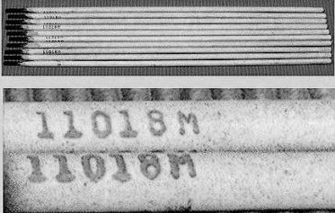
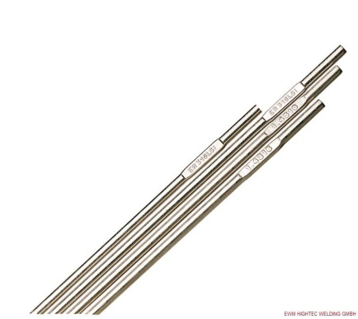
SMAW-----
PRINTED
-------GTAW
STAMPED

Slide 21
CONTRACTOR’S & ATR’S
RESPONSIBILITIES DURING TESTING
8.) Verify with the UA Weld Test Specification that the direction of weld progression is correct.
Verify with the UA Weld Test Specification that the coupon is in the correct test position.
e.g., 1-G, 2-G, 5-G, or 6-G

Slide 22
1G or 1-GR “ROLLED” WELDING ON TOP
PIPE HORIZONTAL

Slide 23
2-G HORIZONTAL WELDING,
PIPE VERTICLE

Slide 24
5-G VERTICLE WELDING
PIPE HORIZONTAL

Slide 25
6-G 45 DEGREE INCLINED WELDING
PIPE @ 45 DEGREE ANGLE

Slide 26
CONTRACTOR’S & ATR’S
RESPONSIBILITIES DURING TESTING
9.) Verify with the UA Weld Test Specification that the selected amperage is within ranges specified by the WPS. Wire feed speed, voltage, polarity and current can also be verified on this specification document.

Slide 27
CONTRACTOR’S & ATR’S
RESPONSIBILITIES DURING TESTING
10.) Verify approximate thickness of the weld metal deposited with each process and filler metal type when more than one process or filler metal type is used.
Deposited weld metal ranges may be found on the UA Weld Test Specification or Welder Qualification Record.

Slide 29
CONTRACTOR’S & ATR’S
RESPONSIBILITIES DURING TESTING
11.) Verify proper backing gas and flow rates; torch and weld head gas and their proper mixtures, including flow rate ranges, can also be found on the UA Weld Test Specification sheet.

Slide 30
CONTRACTOR’S & ATR’S
RESPONSIBILITIES DURING TESTING
12.) The cover pass must be left in the
“as welded” condition, cleaning with power or hand wire brush is allowed, (grinding or filing on the completed test coupon inside or outside is not allowed).
Per UA Weld Test Specifications

Slide 31
CONTRACTOR’S & ATR’S
RESPONSIBILITIES DURING TESTING
13.) Safety Check: a continuous safety check for required Personal Protective Equipment is critical. The testing area shall have Adequate Ventilation and be protected from the elements.

Slide 32
CONTRACTOR’S & ATR’S
RESPONSIBILITIES DURING TESTING
14.) “If at anytime during a weld test the ATR or Contractor Representative determines the welder does not demonstrate the necessary welding skills the weld test shall be terminated.”

Slide 33
NCPWB
WELDER/BRAZER PERFORMANCE QUALIFICATIONS
CONDUCTING VISUAL EXAMINATIONS
SECTION – II.

Slide 34
II. CONTRACTOR’S & ATR’S
RESPONSIBILITIES
DURING A TESTING EVENT
After the welder has completed welding any portion of the test coupon and has called for inspection, the Contractor and the UA Authorized Testing Representative (ATR) shall Visually Examine the entire test coupon inside and outside for the following:

Slide 35
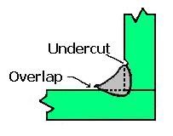
Undercut (not to exceed 1/32”) and Overlap / Cold Lap
(none permitted)

Slide 36
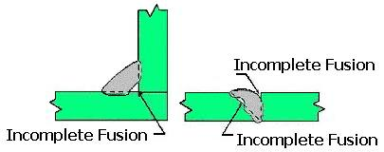
Incomplete Fusion (none permitted)
a.) in the root.
b.) in the side wall.
c.) on the cover pass.

Slide 37
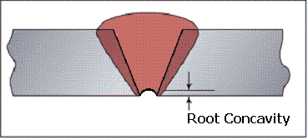
Root Concavity / Suck Back
(none permitted)

Slide 38
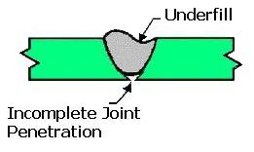
Underfill
and
Incomplete Joint Penetration
(none permitted)

Slide 39
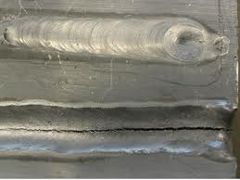
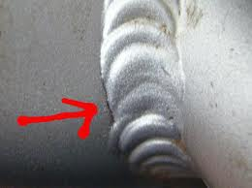
Cracks (none permitted)

Slide 40
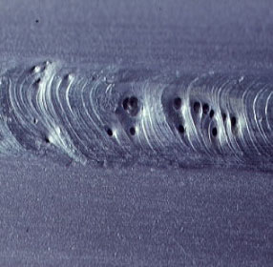
Porosity (none permitted)

Slide 41
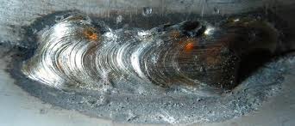
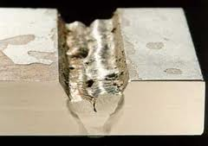
Slag (none permitted)
Trapped / Included

Slide 42
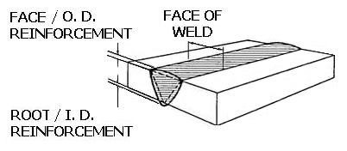
Weld Reinforcement
“per UA Weld Test Specifications”

Slide 43
CONTRACTOR’S & ATR’S
RESPONSIBILITIES DURING TESTING
“If at anytime during a weld test the ATR or Contractor Representative determines the welder does not demonstrate the necessary welding skills the weld test shall be terminated.”

Slide 44
NCPWB
WELDER/BRAZER PERFORMANCE QUALIFICATIONS
CONTINUITY UPDATES
SECTION – III.

Slide 45
III. CONTRACTOR’S & ATR’S
RESPONSIBILITIES
DURING CONTINUITY UPDATES
ASME SECTION IX – QW-322.1a
“When a welder or welding operator has not welded with a process during a period of six months or more, his qualifications for that process shall expire.”

Slide 46
III. CONTRACTOR’S & ATR’S
RESPONSIBILITIES
DURING CONTINUITY UPDATES
ASME SECTION IX – QW-322.1(1)
“when the welder has welded with that process under the supervision and control of the qualifying manufacturer or contractor or participating organization that will extend his qualifications for an additional 6 months.”

Slide 47
WELDER QUALIFICATION CONTINUITY UPDATES
UA WCP Quality System Manual:
“when unable to maintain continuity from an Employing Manufacturer/Contractor, continuity updates may take place at any UA Authorized Testing Facility and must be supervised by an ATR and at least one Manufacturer / Contractor Representative.”

Slide 48
WELDER QUALIFICATION CONTINUITY UPDATES
UA WCP Quality System Manual:
“the continuity demonstration shall consist of welding a minimum of one complete pass for each welding process they are qualified in, using a pipe coupon, in accordance with a UA Weld Test Specification applicable to the welding process involved.”

Slide 49
WELDER QUALIFICATION CONTINUITY UPDATES
UA WCP Quality System Manual:
“the continuity report lists the Welder’s name, last date each welding process was demonstrated by the individual and is signed and dated by the supervising Representative of the Employing Manufacturer/Contractor.”

Slide 51
CONTRACTOR’S & ATR’S
RESPONSIBILITIES DURING TESTING
“If at anytime during a continuity update the ATR or Contractor Representative determines the welder does not demonstrate the necessary welding skills the continuity update shall be terminated.”

Slide 52
NCPWB
WELDER/BRAZER PERFORMANCE QUALIFICATIONS
THE END
QUESTIONS & ANSWERS

